Slide 1
International Medical Health Organization Early Childhood Project 2020
Rajam Theventhiran, MD
President – IMHO USA
Mr.S.Krishnakumar
BSc.Dip in Ed SLEAS – I
Country Director
IMHO-Lanka

Slide 2
Improve Behavioral Changes in Early Childhood towards Education and Healthy Lifestyle
Phase 1 - 2020:
Implement Early Childhood Development Project in Madhu and Vavuniya.
Phase 2:
Livelihood program related to the area considering in phase 1.

Slide 3
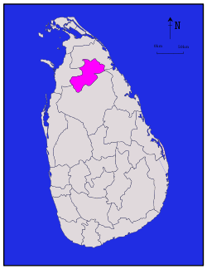
Implementing Areas
Phase 1
Madhu Education Zone - Manthai West Division
Vavuniya North Education Zone - Omanthai Division
Nedunkerni Division
Division | Number of Cluster Schools | Number of Pre-Schools | Number of Teachers | Number of Students
Manthai West | 06 | 43 | 69 | 780
Nedunkerny | 8 | 40 | 51 | 667
Omanthai | 12 | 51 | 64 | 536
Total | 26 | 134 | 184 | 1983

Slide 4
Project Includes
1. Approval and Baseline study
2. Capacity development of Teachers
3. Infrastructure development for 8 model schools & Management
4. Improvement of Parents’ and Children’s Health

Slide 5
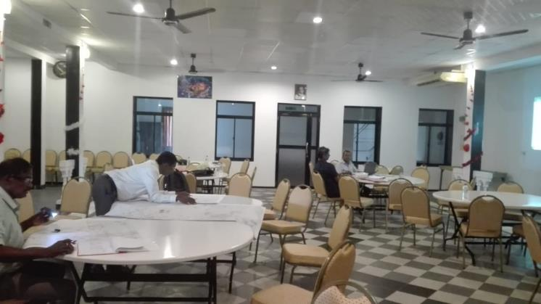
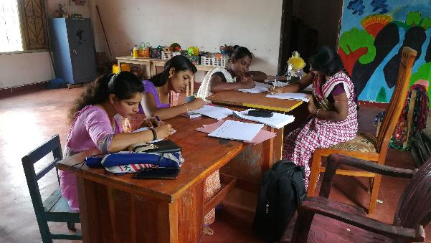
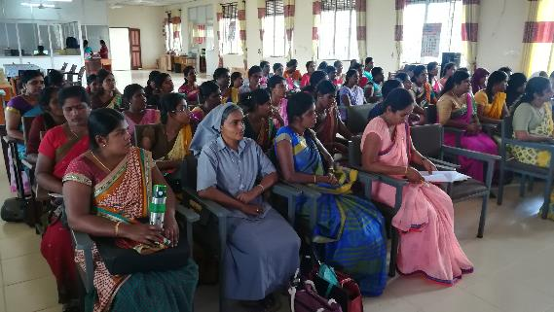
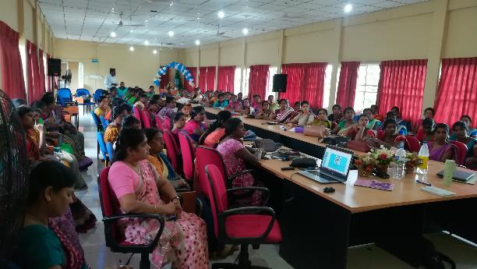
1. Approval and Baseline study
Approval by Secretary, MOE, NP.
Baseline study for phase 1.
Introductory workshop regarding the Project.

Slide 6
2. Capacity development of Teachers
Assist teachers to reach adequate educational qualifications
Provide opportunities to get vocational qualifications
Encourage practical based, child friendly and participatory learning approaches through Activity Based Training
Provide training to teachers to identify the children with special needs.
Establish model school.
Provide ToT training to the selected pre-school teachers.
Provide trainings with the support of these ToTs at the model school.

Slide 7
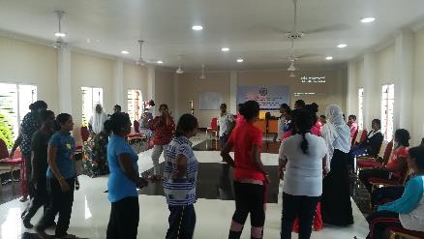
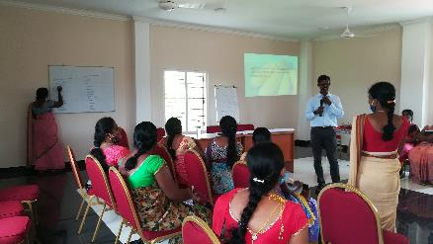
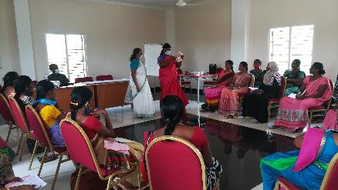
Activity Based Training
4 Days Residential Workshop for 68 Teachers as 2 batches (Manthai west and Maskeliya)
Contents of the Workshop
Cognitive related matters (Language, Mathematics)
Realising the situation and acting.
Development of creative and innovative activities
Emotional development activities, aesthetic studies, creative activities.
Finding out the needy forms and preparing model tables to enter the programmes
Matters related to chid rights and quality circle.
Pre-school management, leadership
Non-violence communication
Importance of keeping registers.

Slide 8
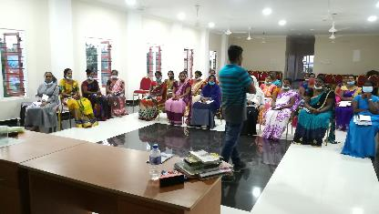
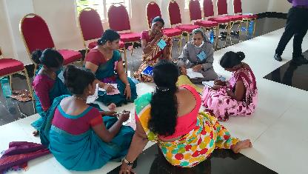
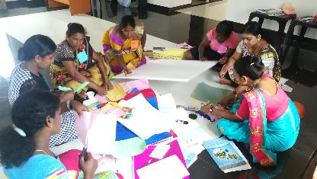
Activity Based Training cont…..
Contents of the Workshop
Oral Health
Healthy food habits
Management of Home Gardening
Breathing Exercises
Psychological Wellbeing for Children and Teachers
An Introduction – Pre school
Activities for Pre school Teachers
Presentation skills
Integrated Approaches in Teaching and Learning Park
Subjects related to physical development and Group activities

Slide 9
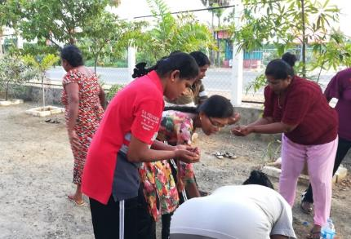
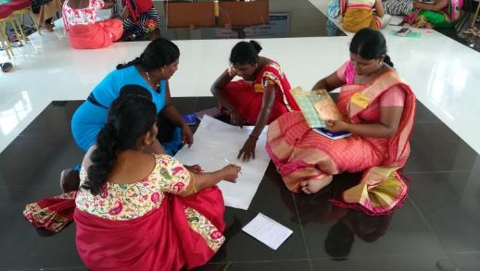
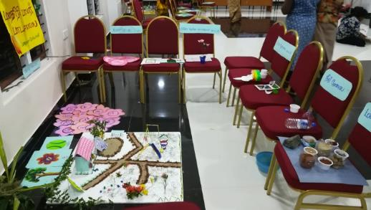
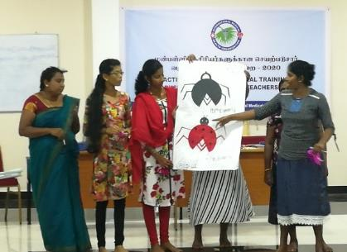
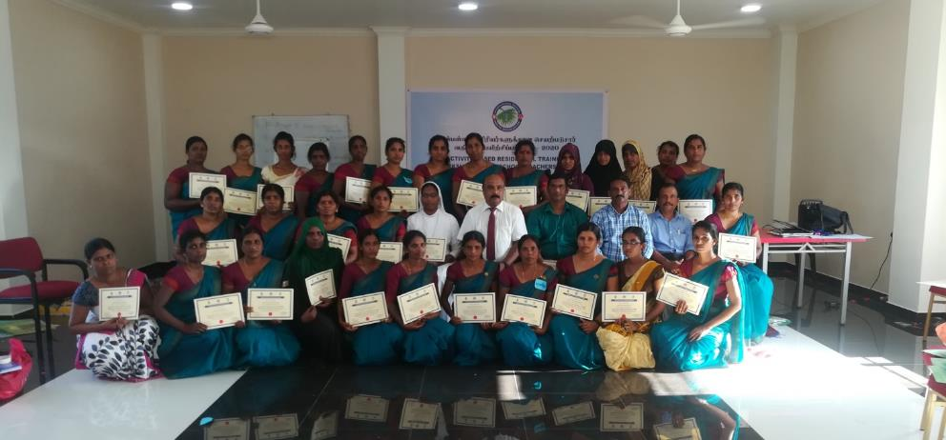
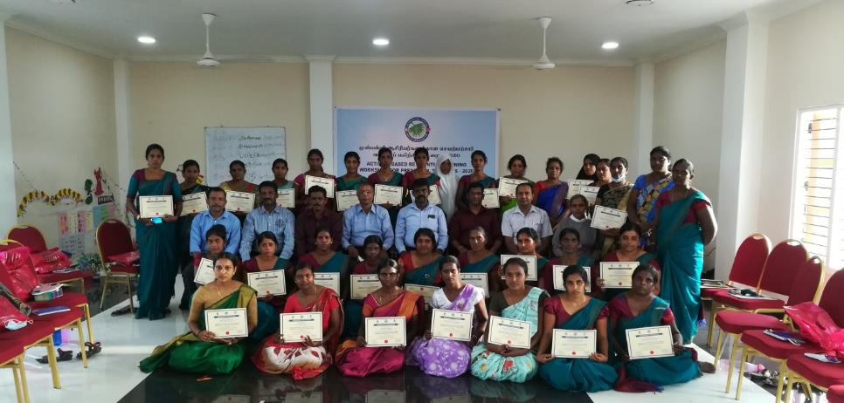
Activity Based Training cont…..

Slide 10
3. Infrastructure development for 8 model schools & Management
a. Provision of Study Tools
b. Improve Physical Resources (Building, Drinking Water and Sanitation)
c. Strengthening Management Committee

Slide 11
a. Provision of Study Tools
Furniture
Teachers Table
Teachers Chair
Children’s Table
Children’s Chair
Cupboard
Books rack
White board
Notice board
First Aid box
Dust bin
Name board
Learning Equipment
Television
Audio system
Pen Drive
Learning tools
Banners with story pictures
Western musical instrument

Slide 12
b. Improve Physical Resources (Building, Drinking Water and Sanitation)
Vavuniya North Education Zone (05)
Madhu Education Zone (03)
Omanthai Division
Kalaimahal Pre-school
Inkaran Pre-school
Tharanichudar Pre-school
Nedunkerny Division
Ilanthalir Pre-school
Muththumarinagar Pre-school
Manthai West Division
Kathankulam Pre-school
Nedunkulam Pre-school
St. Antony’s Pre-school

Slide 13
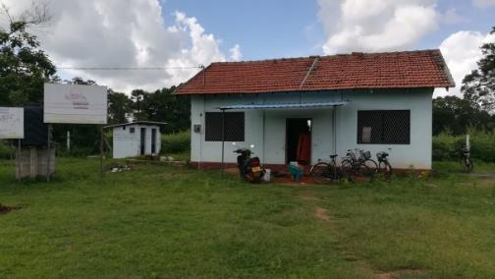
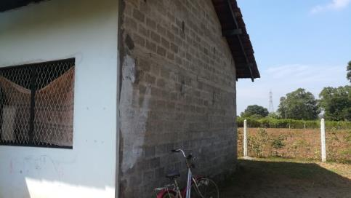
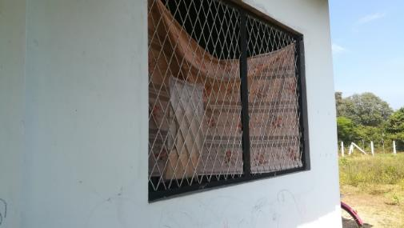
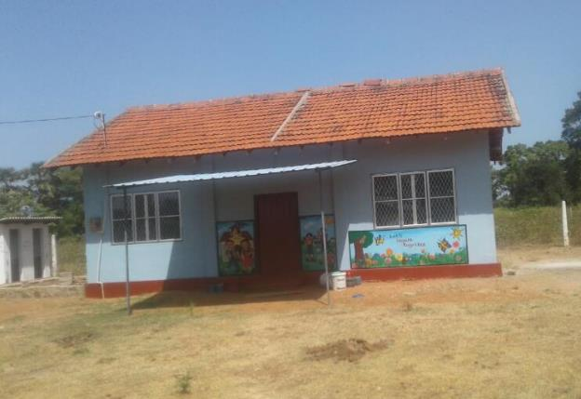
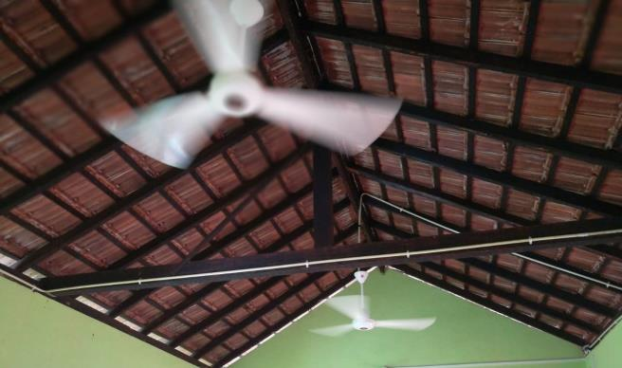
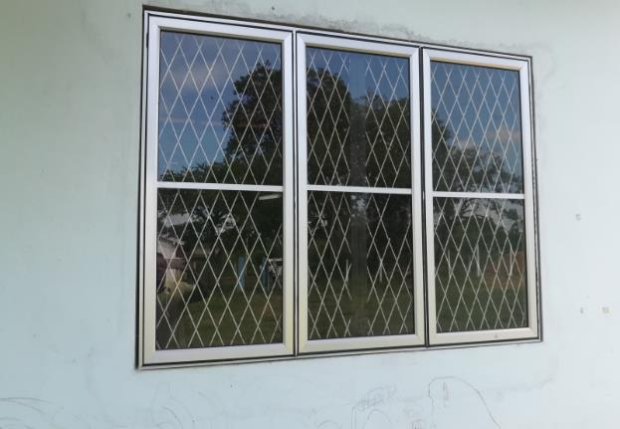
b. Improve Physical Resources (Building, Drinking Water and Sanitation) Cont…
Kalaimahal Pre-school - Omanthai
Before
After

Slide 14
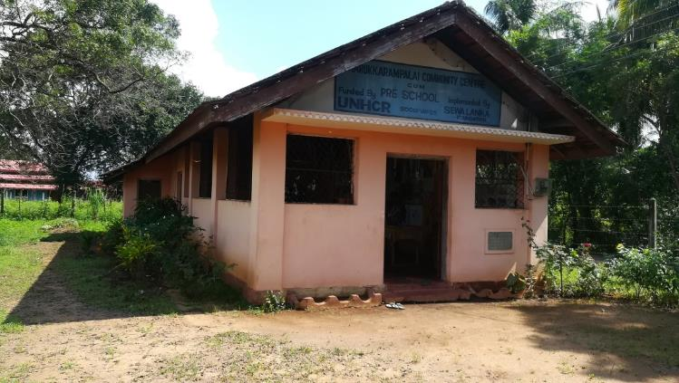
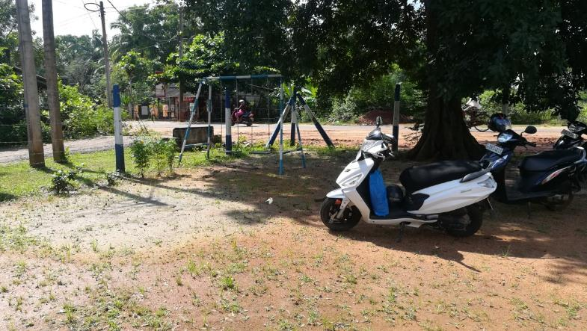
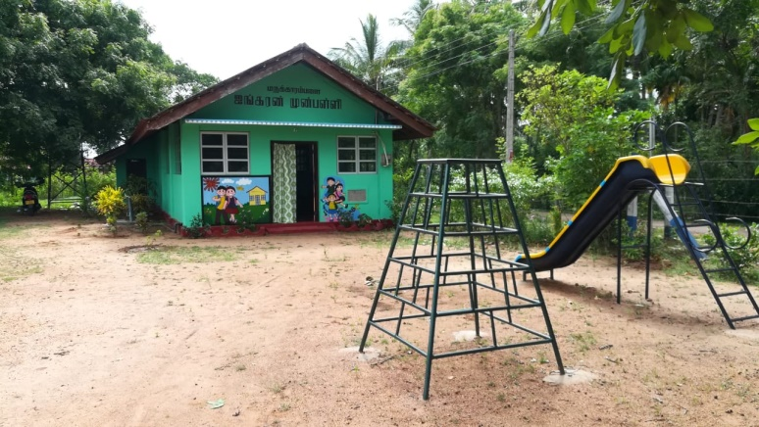
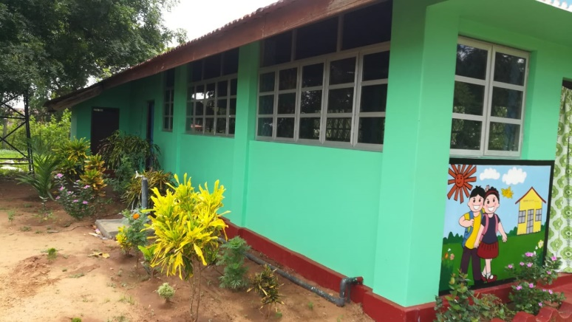
b. Improve Physical Resources (Building, Drinking Water and Sanitation) Cont…
Inkaran Pre-school - Marakarampalai
Before
After

Slide 15
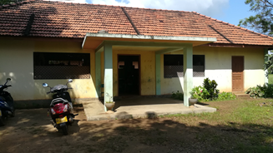
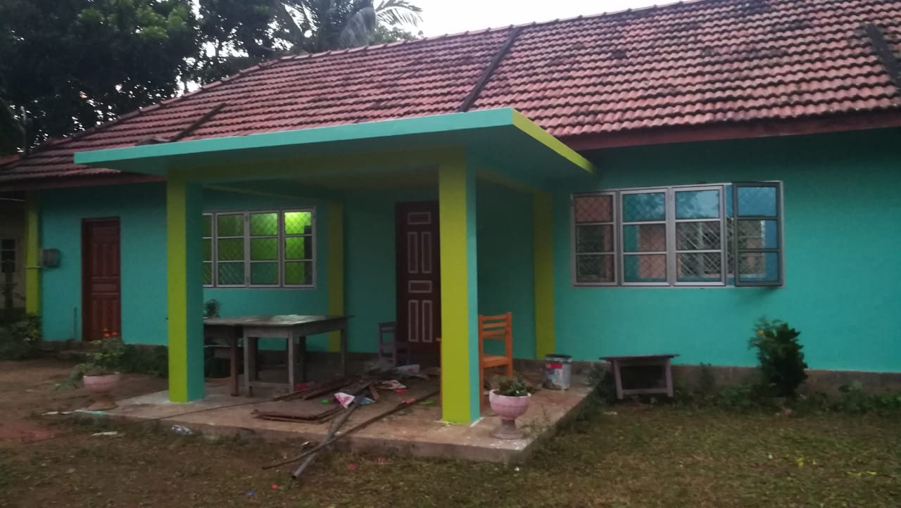
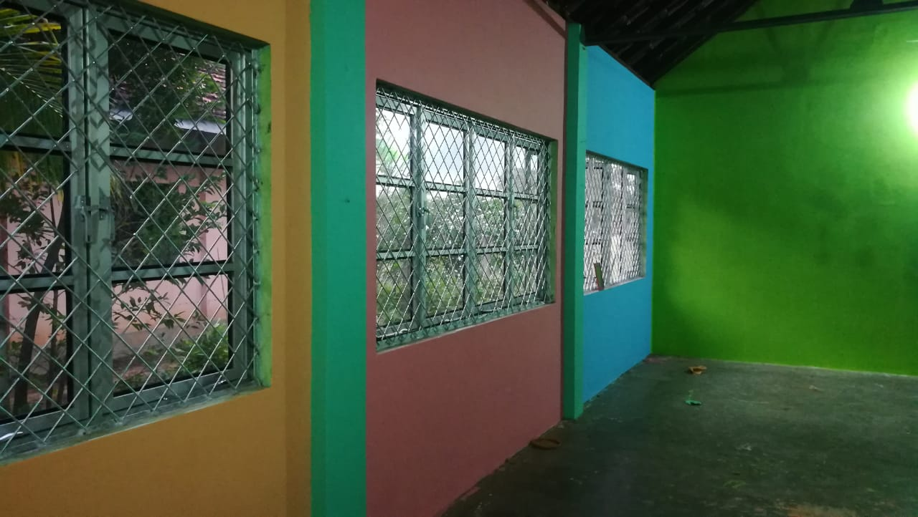
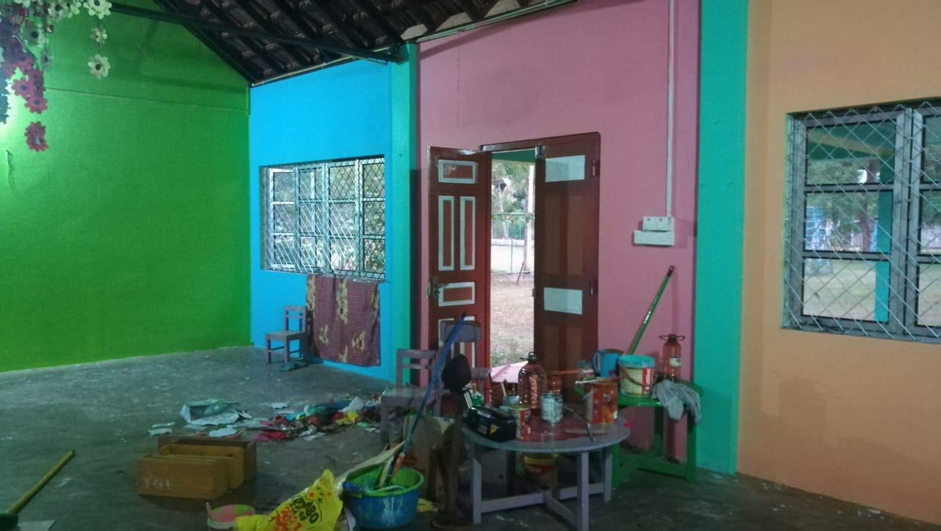
b. Improve Physical Resources (Building, Drinking Water and Sanitation) Cont…
Tharanichudar Pre-school, Tharanikulam
Before
After

Slide 16
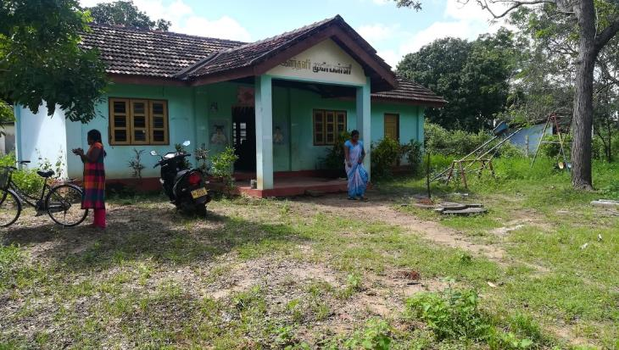
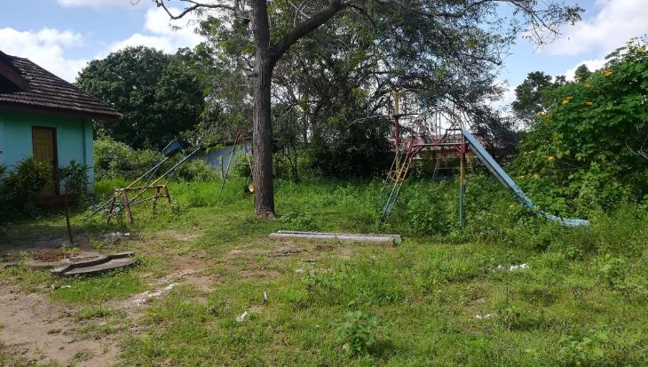
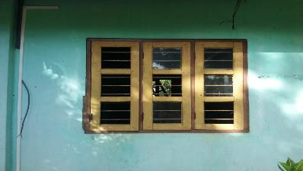
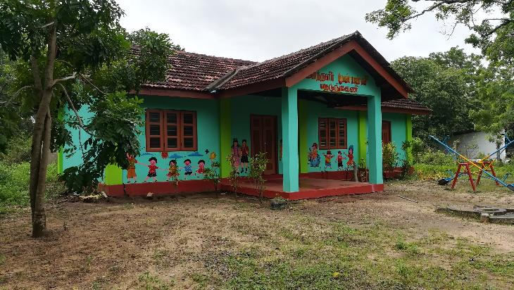
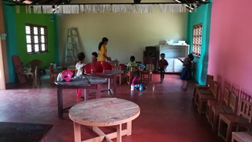
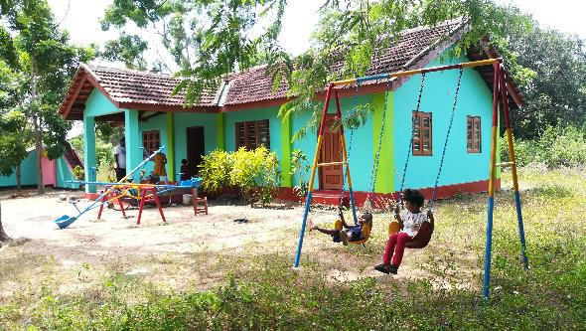
b. Improve Physical Resources (Building, Drinking Water and Sanitation) Cont…
Ilanthalir Pre-school, Nedunkerny
Before
After

Slide 17
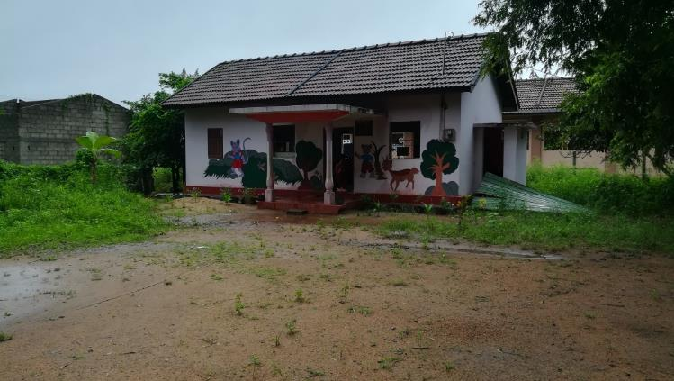
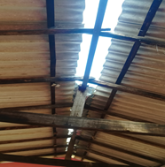
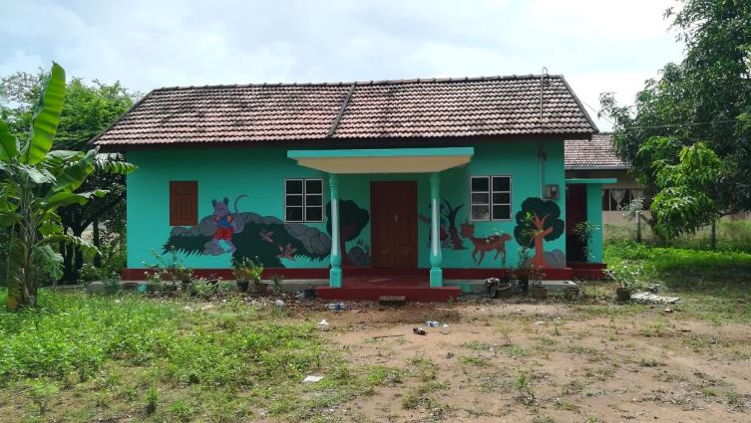
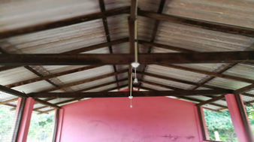
b. Improve Physical Resources (Building, Drinking Water and Sanitation) Cont…
Muthumarinagar Pre school, Puliyankulam
Before
After

Slide 18
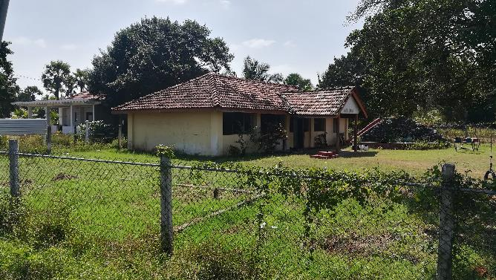
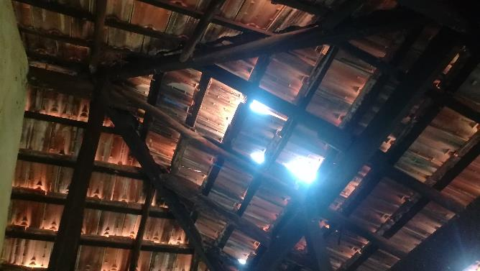
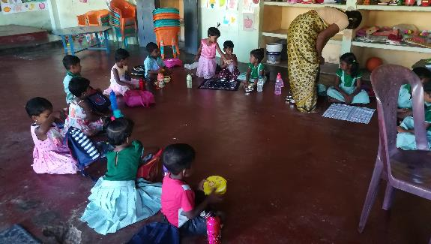
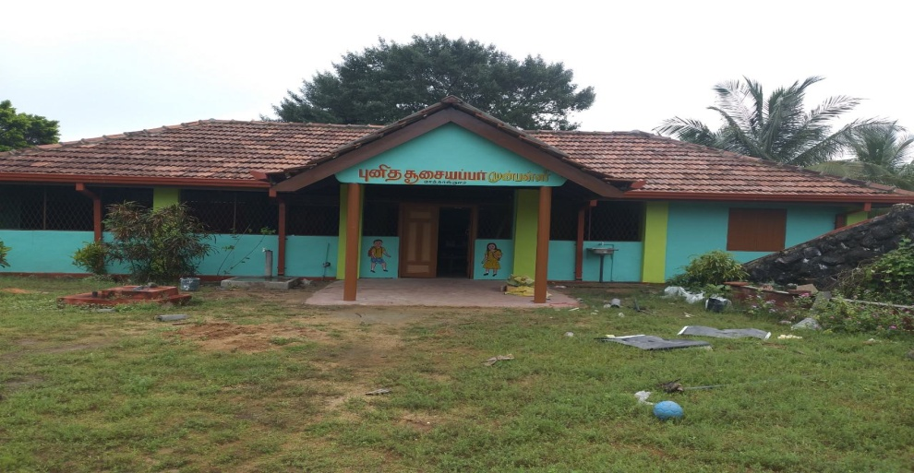
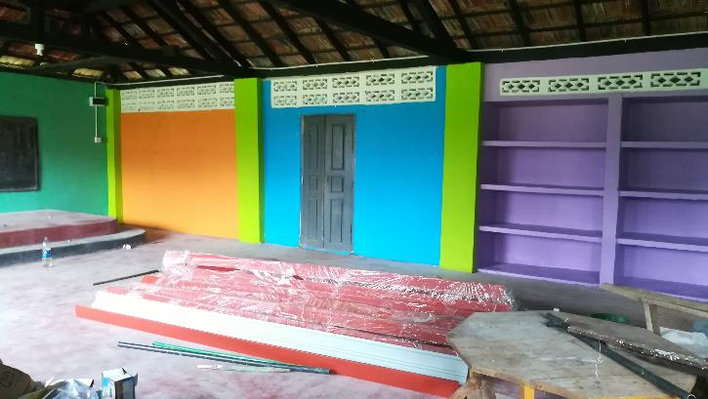
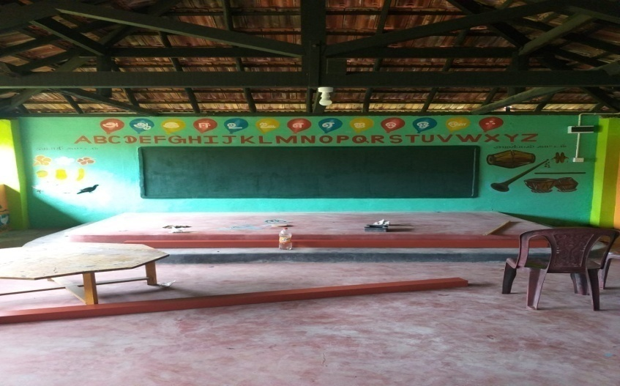
b. Improve Physical Resources (Building, Drinking Water and Sanitation) Cont…
Kathankulam Pre school, Kathankulam
Before
After

Slide 19
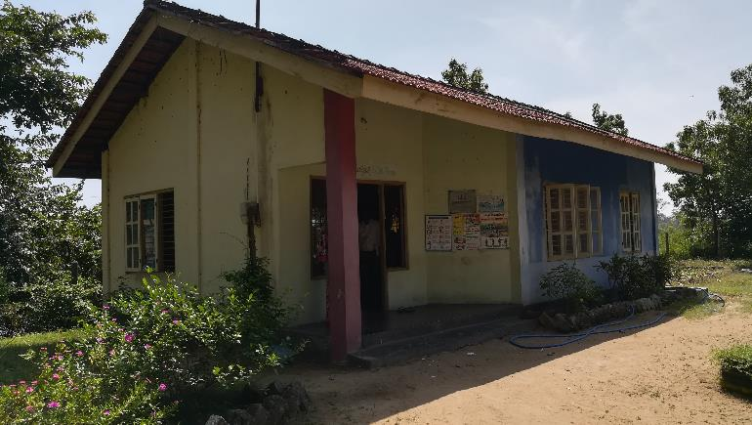
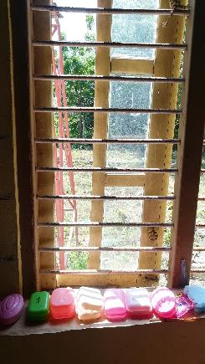
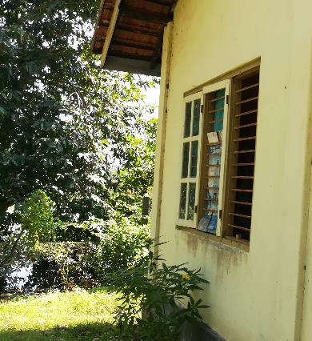
b. Improve Physical Resources (Building, Drinking Water and Sanitation) Cont…
Nedunkulam Pre school, Nedunkulam
Before
After

Slide 20
b. Improve Physical Resources (Building, Drinking Water and Sanitation) Cont…
St. Antony’s Pre school, Anthoniyarpuram

Slide 21
4. Improvement of Parents’ and Children’s Health
a. Organize parents awareness meetings
b. Health activities (Oral Health, Hand washing,…)
c. Nutrition for children
d. Measure health status of children, reporting and make referrals.

Slide 22
Rebuilt New Preschool at Savarikulam
Before
After

Slide 23
Renovation work at Thenudaiyan Preschool
Before
After

Slide 24
Challenges
Schools were closed due to Corona outbreak, when initiated the project.
Since the nature of work and quantity differs for each school, it was difficult to identify the workers / contractors at the respective areas.
Needed to pay high wages to selected labourers / contractors.
Needed to include the cost for meals, transport and accommodation, when labourers / contractors were received from other areas.
Teacher training for Vavuniya North Zone postponed 3 times due to corona.

Slide 25
THANK YOU

