Slide 1
International Medical Health Organization – Lanka IMHO- Lanka
Prepared by: T.Yasotharan - FO

Slide 2
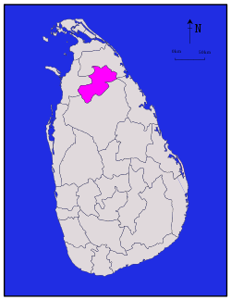
Project
Improve Behavioural Changes in Early Childhood towards Education and Healthy Lifestyle
Implementing Areas
Madhu Education Zone
1. Manthai West Division
Vavuniya North Education Zone
1. Omanthai Division
2. Nedunkerni Division

Slide 3
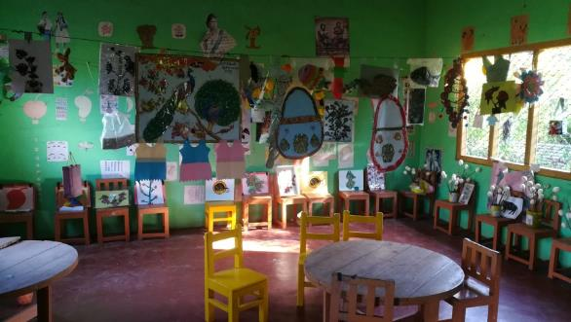
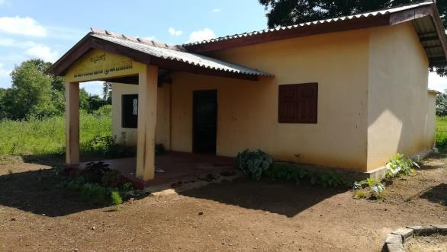
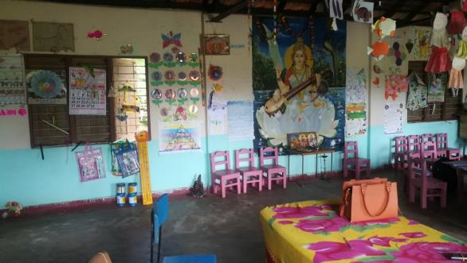
Details of Pre-schools in 2019
Division | Number of Cluster Schools | Number of Pre-Schools | Number of Teachers | Number of Students
Madhu | 06 | 43 | 69 | 780
Nedunkerny | 8 | 40 | 51 | 667
Omanthai | 12 | 51 | 64 | 536
Total | 26 | 134 | 184 | 1983

Slide 4
Project includes
Infrastructure development & Management
Capacity development of Teachers
Improvement of Parents’ and Children’s Health

Slide 5
Project Goals
Infrastructure Development & Management
Improve Physical Resources (Building, Drinking Water and Health Needs)
Provision of Study Tools
Strengthening Management Committee
Encourage children to attend pre-schools
Organize parents awareness meetings
Health activities (Oral Health, Hand washing,…)
Nutrition for children
Measure health status of children, reporting and make referrals.

Slide 6
Capacity development of Teachers
Assist teachers to reach adequate educational qualifications
Provide opportunities to get vocational qualifications
Encourage practical based, child friendly and participatory learning approaches
Provide training to teachers to identify the children with special needs.
Establish pre-school teachers’ resource centre.
Provide ToT training to the President of cluster schools / Experienced, selected pre-school teachers.
Provide trainings with the support of these ToTs at the resource centre.

Slide 7
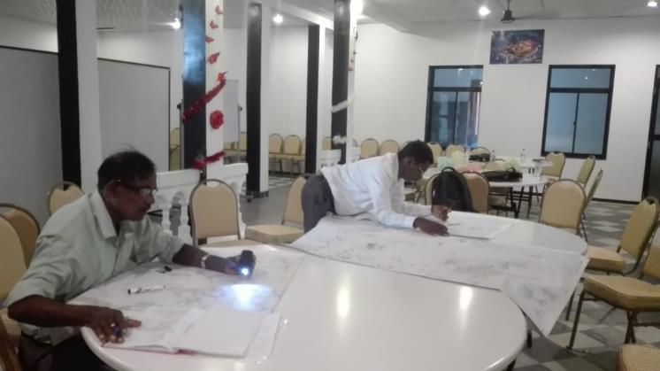
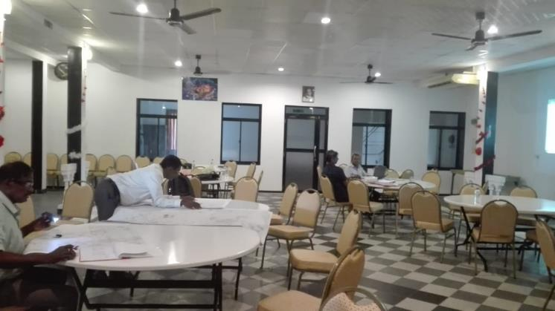
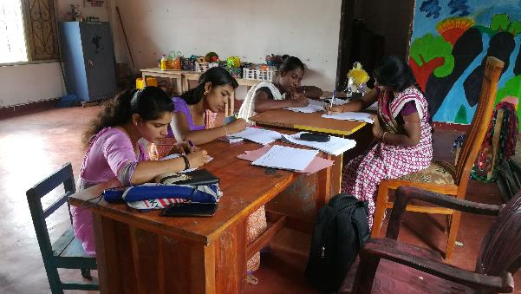
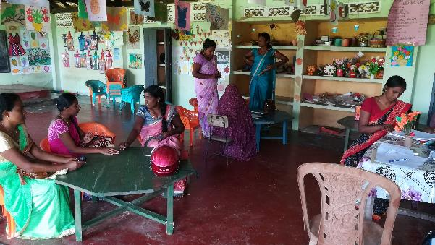
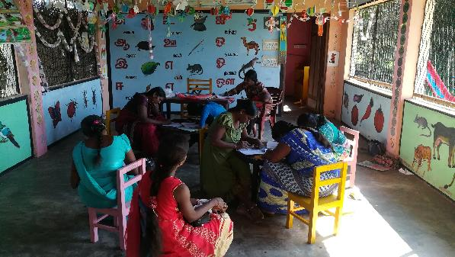
Project Stages
Identifying schools with the support of Assistant Directors of Education….
Collection of information regarding pre-schools, teachers and needs of pre-schools through questionnaires…

Slide 8
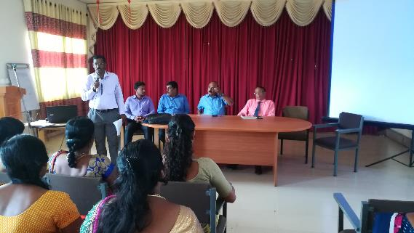
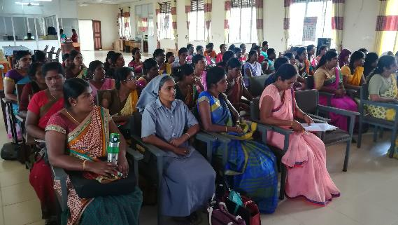
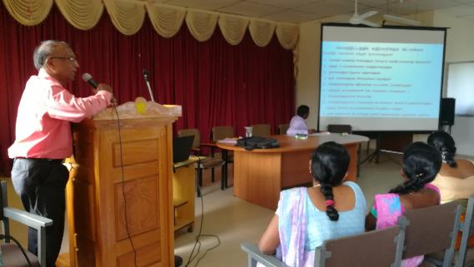
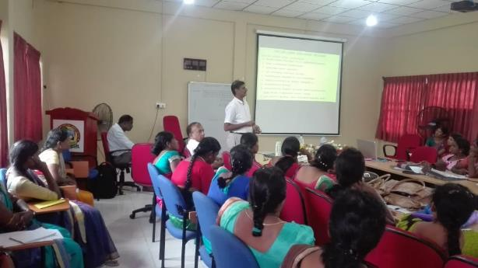
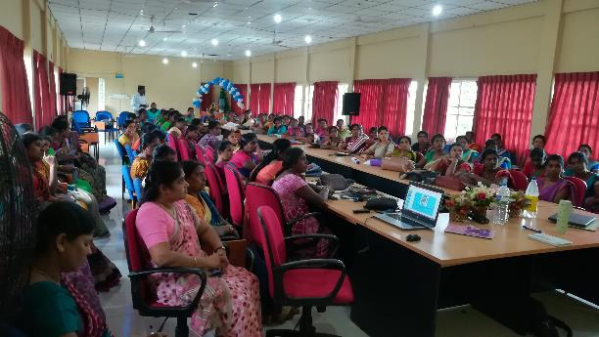
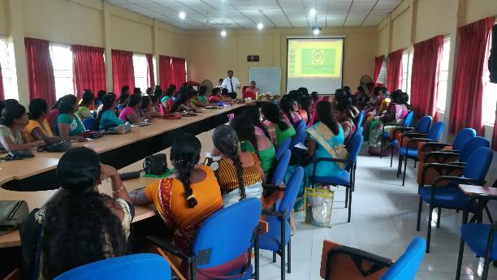
Introductory Workshop regarding the Project
Participants: Zonal Education Directors, Officers from Zonal Planning, Development Unit, Assistant Directors of Education and Pre-school Teachers

Slide 9
Improvement of Physical Resources ( 8 Schools )
Vavuniya North Education Zone (05)
Madhu Education Zone (03)
Omanthai Division
Manthai West Division
01. Kalaimahal Pre-school
01. Kathankulam Pre-school
p
02. Inkaran Pre-school
02. Nedunkulam Pre-school
03. Tharanichudar Pre-school
03. St. Antony’s Pre-school
Nedunkerny Division
04. Ilanthalir Pre-school
p
05. Muththumarinagar Pre-school

Slide 10
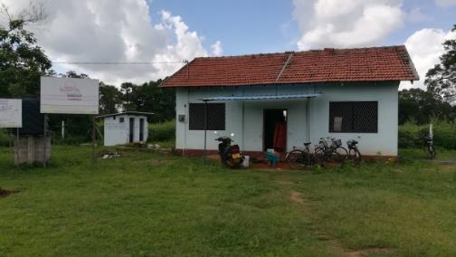
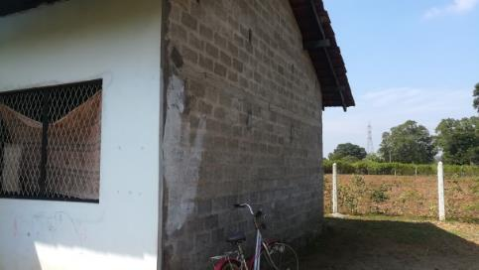
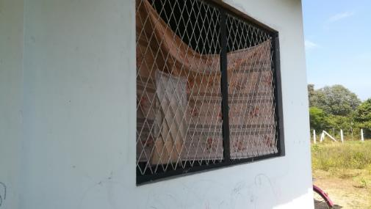
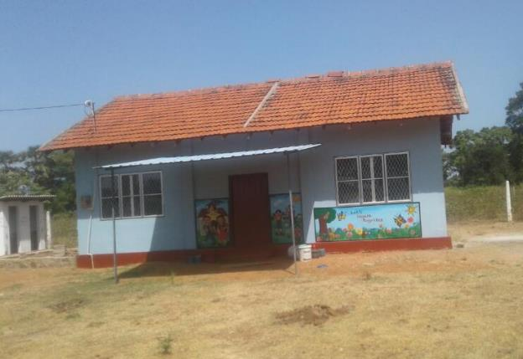
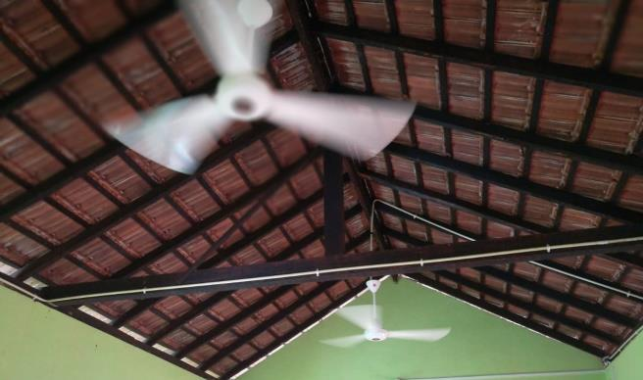
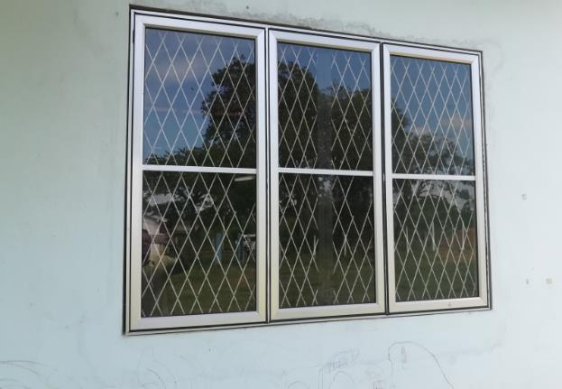
Improvement of Physical Resources
Kalaimahal Pre-school - Omanthai
Before Repair….
After Repair….

Slide 11
Kalaimahal Pre-school - Omanthai
Improvement Works
Details of Works | Amount
1. Plastering Works – Both side walls | 45,000.00
2. Electrical Works | 37,990.00
3. Plumbing works, Fixing electric motor | 33,720.00
4. Fixing glasses, Aluminium doors to windows | 79,200.00
5. Painting | 57,582.00
6. Drawing wall arts | 17,000.00
7. Fixing nets for securing from Bats | 15,395.00
Total | 285,887.00

Slide 12
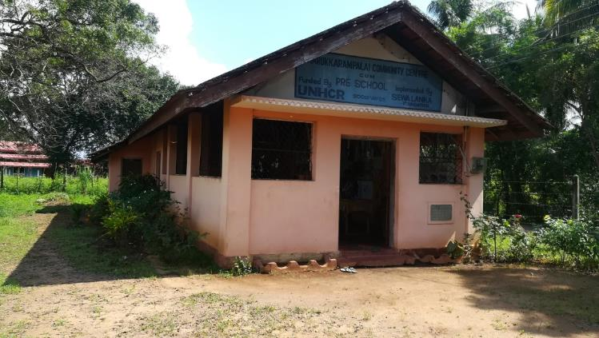
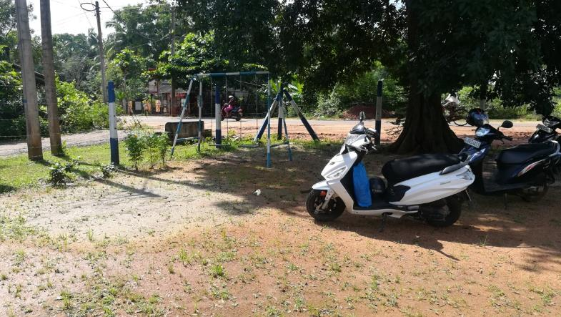
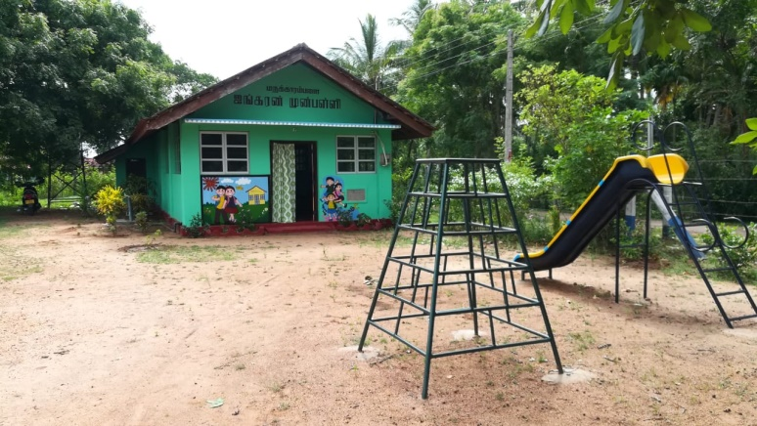
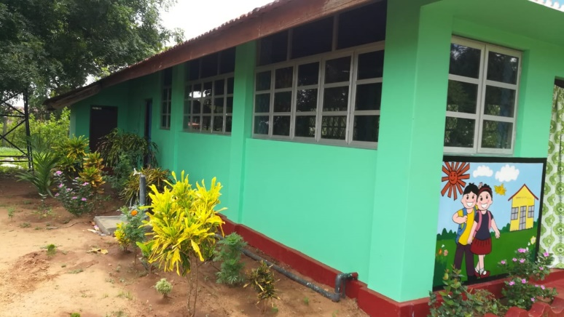
Inkaran Pre-school - Marakarampalai
Before Repair….
After Repair….

Slide 13
Inkaran Pre-school - Marakarampalai
Improvement Works
Details of Works | Amount
1. Front side door | 24,000.00
2. Electrical Works | 36,505.00
3. Installation of water tank and plumbing works | 39,650.00
4. Fixing glasses, Aluminium doors to windows | 175,200.00
5. Painting | 62,900.00
6. Drawing wall arts | 17,000.00
7. Provision of external play equipment | 142,800.00
8. Fixing nets for securing from Bats
Total | 498,055.00

Slide 14
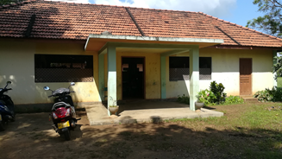
Tharanichudar Pre-school, Tharanikulam
Improvement Works
Details of Works | Amount
1. Front side door, Fixing nets for securing from Bats | 34,900.00
2. Electrical Works | 47,476.00
3. Repair of external play equipment
4. Fixing glasses, Aluminium doors to windows
5. Painting
6. Drawing wall arts
Total | 82,376.00
Work will be completed at the end of this month

Slide 15
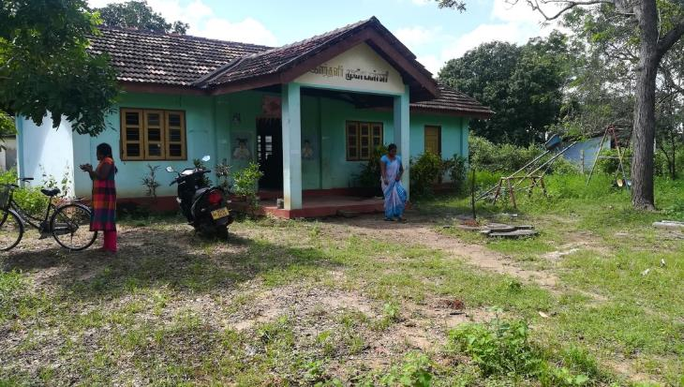
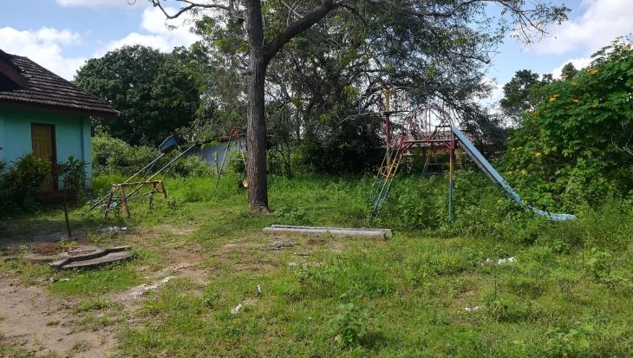
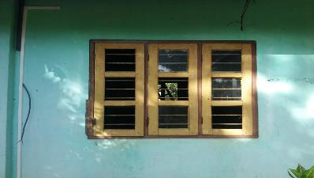
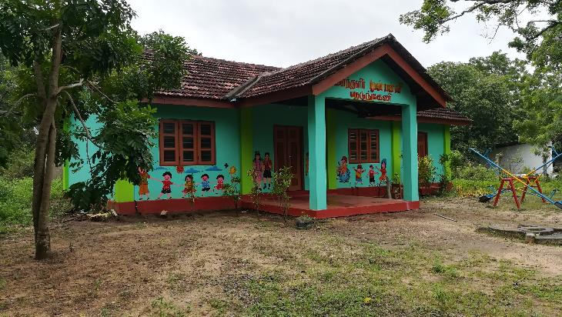
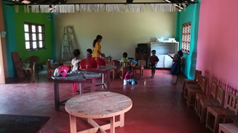
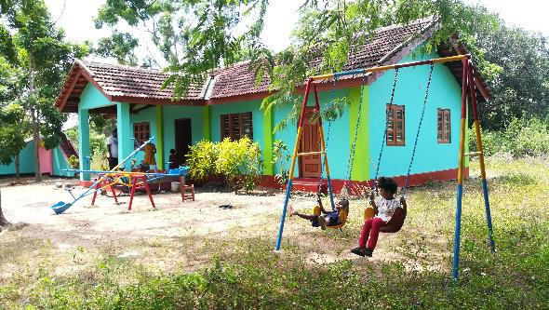
Ilanthalir Pre-school, Nedunkerny
Before Repair….
After Repair….

Slide 16
Ilanthalir Pre-school, Nedunkerny
Improvement Works
Details of Works | Amount
1. Repairs of Doors, Windows, Roof & External Play Equipment and fixing nets for securing from Bats | 61,250.00
2. Electrical Works | 69,800.00
3. Painting | 142,390.00
4. Drawing wall arts | 15,000.00
Total | 288,440.00

Slide 17
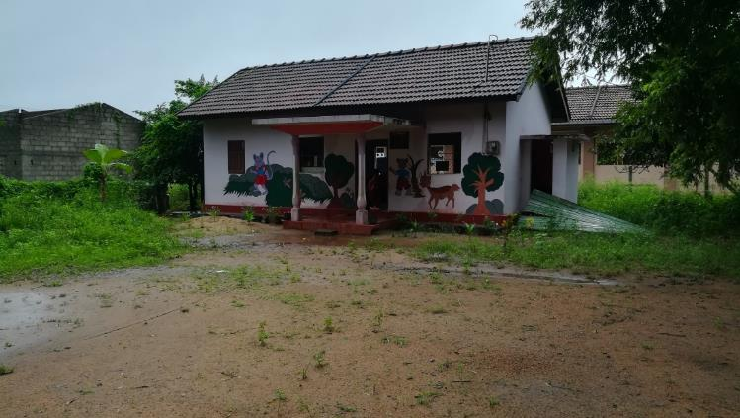
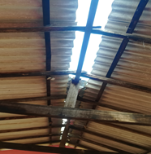
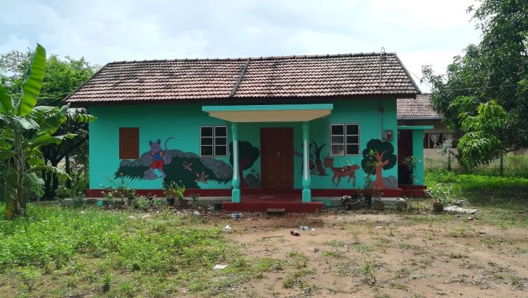
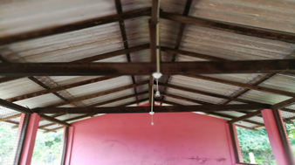
Muthumarinagar Pre school, Puliyankulam
Before Repair….
After Repair….

Slide 18
Muthumarinagar Pre school, Puliyankulam
Improvement Works
Details of Works | Amount
1. Electrical Works | 63,955.00
2. Fixing glasses, Aluminium doors to windows
3. Kitchen Roof, Door repair | 58,900.00
4. Drawing wall arts | 15,000.00
5. Painting | 87,300.00
Total | 225,155.00

Slide 19
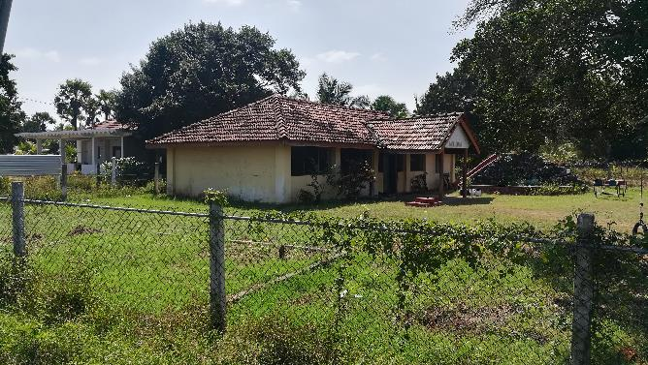
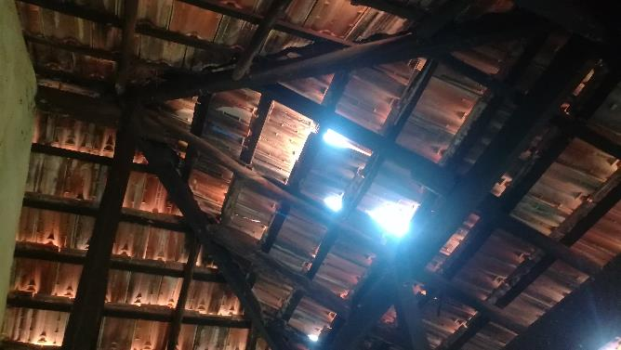
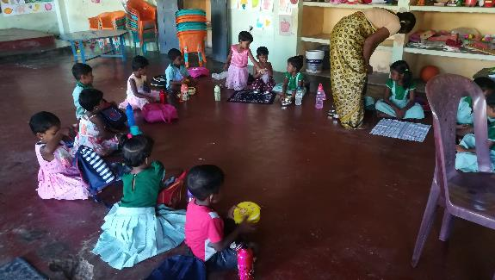
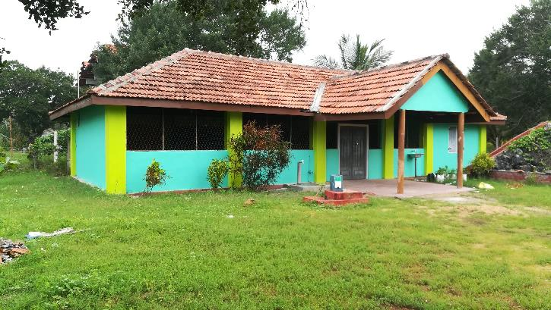
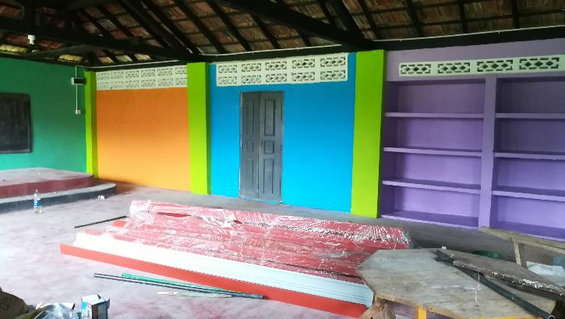
Kathankulam Pre school, Kathankulam
Before….
During repair time (will be completed at the end of this month)

Slide 20
Kathankulam Pre school, Kathankulam
Improvement Works
Details of Works | Amount
1. New Electricity Connection and Electrical Works | 52,875.00
2. Repair of walls | 39,410.00
3. Repair of Doors & Windows | 40,370.00
4. Drawing wall arts
5. Painting | 58,470.00
6. Plumbing works | 5,000.00
7. Fixing nets for securing from Bats
Total | 196,125.00

Slide 21
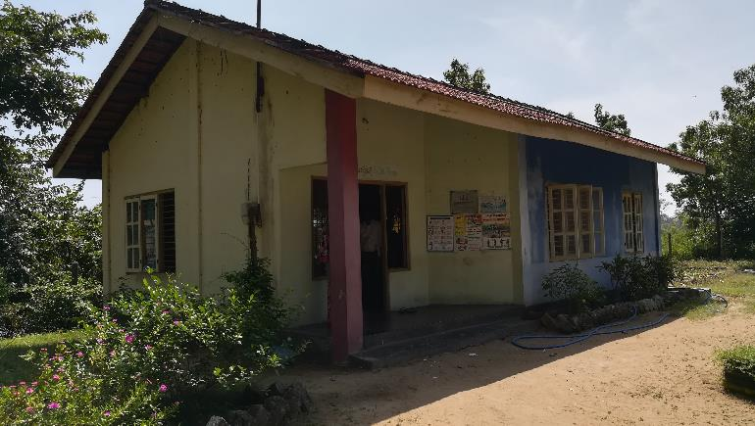
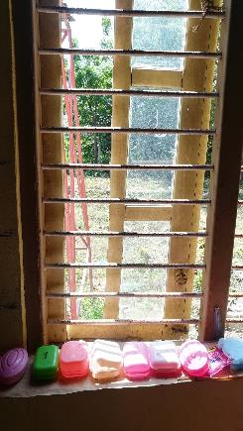
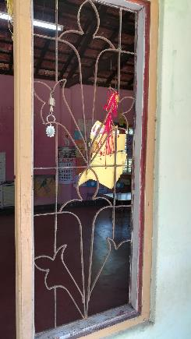
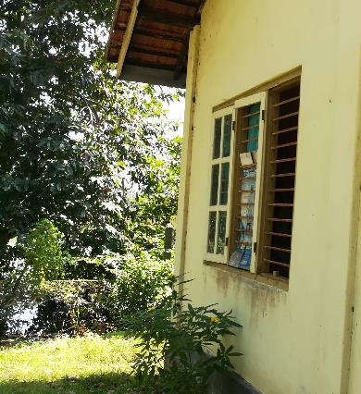
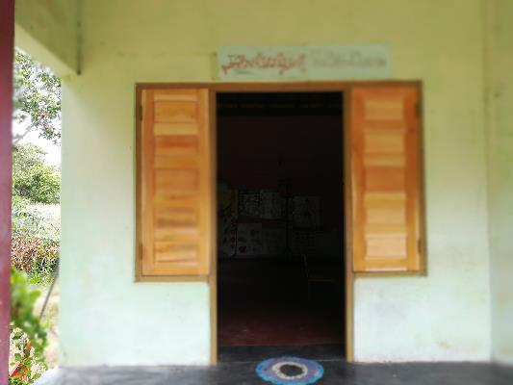
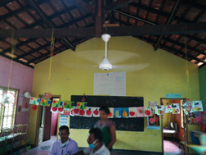
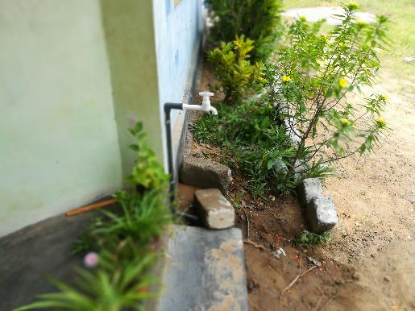
Nedunkulam Pre school, Nedunkulam
Before….
During repair time (will be completed at the end of this month)

Slide 22
Nedunkulam Pre school, Nedunkulam
Improvement Works
Details of Works | Amount
1. Electrical Works | 16,485.00
2. Plumbing works | 4,150.00
3. Repair of Doors & Windows | 33,090.00
4. Drawing wall arts
5. Painting
Total | 53,725.00

Slide 23
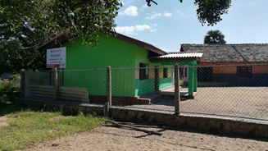
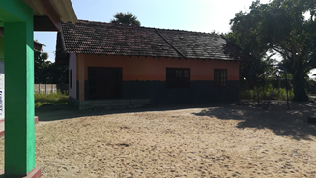
St. Antony’s Pre school, Anthoniyarpuram
Work will be completed at the end of this month

Slide 24
Savarikulam Pre school, Savarikulam
This school was selected in addition to the 8 selected schools and all the works will be completed at the end of this month

Slide 25
Thenudaiyan Pre school, Thenudaiyan
This school was selected in addition to the 8 selected schools and all the works have been completed

Slide 26
Thenudaiyan Pre school, Thenudaiyan
Improvement Works
Details of Works | Amount
1. Repair of Doors & Windows | 56>350.00
2. Plumbing works | 9>270.00
3. Concrete floor work
4. Fixing nets for securing from Bats | 8>000.00
5. Painting | 79>630.00
6. Drawing wall arts | 17>000.00
7. Repair of Toilet | 3>000.00
Total | 173>250.00

Slide 27
Purchasing Items
1. Furniture
2. Learning Equipment
Teachers Table
Teachers Chair
Children’s Table
Children’s Chair
Cupboard
Books rack
White board
Notice board
First Aid box
Dust bin
Name board
Television
Audio system
Pen Drive
Learning tools
Banners with story pictures
Western musical instrument
Quotations have been obtained. Purchasing will be made, once schools started

Slide 28
Price List for Learning Tools

Slide 29
Capacity Development for Teachers
Teacher training - 2 batches completed
ToT for selected teachers
Diploma in preschool Education
Parents Awareness
Special Training for Preschool Teachers on early Identification with disabilities
Strengthen Management Committees
Progress Meetings at Zonal Office

Slide 30
Capacity Development for Teachers

Slide 31
Capacity Development for Teachers
5 Days Residential Workshop for 68 Teachers as 2 batches
Contents of the Workshop
Oral Health
Healthy food habits
Management of Home Gardening
Breathing Exercises
Psychological Wellbeing for Children and Teachers
An Introduction – Pre school
Activities for Pre school Teachers
Presentation skills
Integrated Approaches in Teaching and Learning Park
Subjects related to physical development and Group activities

Slide 32
Capacity Development for Teachers Cont…
Contents of the Workshop
Cognitive related matters (Language, Mathematics)
Realising the situation and acting.
Development of creative and innovative activities
Emotional development activities, aesthetic studies, creative activities.
Finding out the needy forms and preparing model tables to enter the programmes
Matters related to chid rights and quality circle.
Pre-school management, leadership
Non-violence communication
Importance of keeping registers.

Slide 33
Challenges
Schools were closed due to Corona outbreak, when initiated the project.
Since the nature of work and quantity differs for each school, it was difficult to identify the workers / contractors at the respective areas.
Needed to pay high wages to selected labourers / contractors.
Needed to include the cost for meals, transport and accommodation, when labourers / contractors were received from other areas.

Slide 34
Thank Youp

